Slide 1
Statistical Learning - Probability and Distributions- Week 2

Slide 2
Topics covered in Week 2
Probability – Meaning and concepts
Rules for Computing Probability(Multiplicative and Addition rule)
Marginal probability
Bayes’ theorem
Probability Distribution and types

Slide 3
Session Agenda
Probability – Meaning and concepts
Rules for Computing Probability(Multiplicative and Addition rule)
Marginal probability
Bayes’ theorem
Probability Distribution and types
Case study
Questions

Slide 5
Probability – Meaning & Concepts
Probability refers to chance or likelihood of a particular event-taking place.
An event is an outcome of an experiment.
An experiment is a process that is performed to understand and observe possible outcomes.
Set of all outcomes of an experiment is called the sample space.

Slide 6
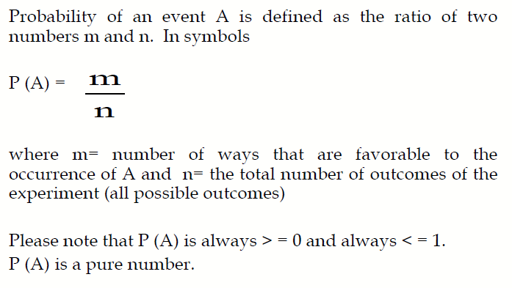
Definition of Probability

Slide 8
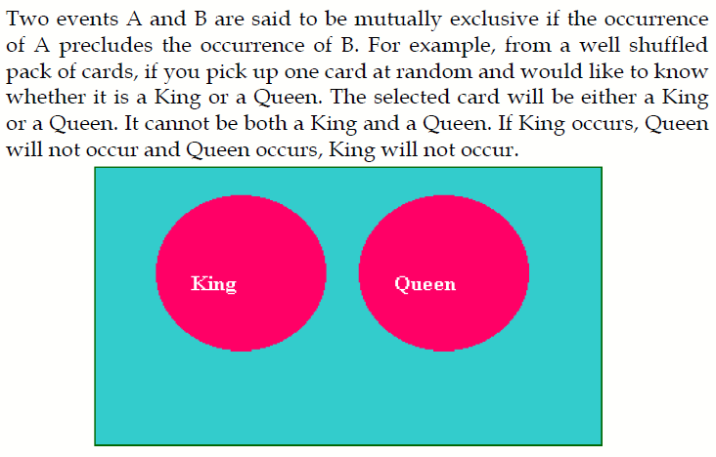
Mutually Exclusive Events
Turning the car left and right at a time
When you roll a dice occurring even or odd number

Slide 10
Independent Events
Two events A and B are said to be independent if the occurrence of A is in no way influenced by the occurrence of B. Likewise occurrence of B is in no way influenced by the occurrence of A.
You flip a coin and get a head and you flip a second coin and get a tail. The two coins don’t influence each other.
NON-INDEPENDENT events:
You draw one card from a deck and its black and you draw a second card and it’s black. By removing one black card, you made the probability of drawing a second one slightly smaller. Technically this is called ‘sampling without replacement’.
The probability of a huge Rain today and the probability that the local airport will be closed to flights sometime today.
Severe storms mean that airports sometimes need to close.

Slide 11
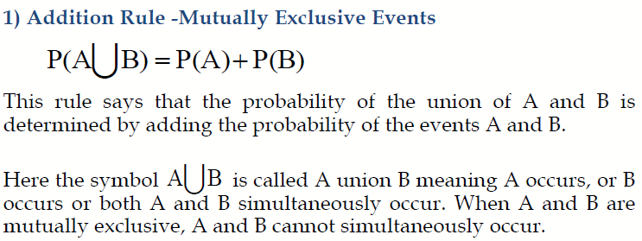
Rules for Computing Probability
In a pet store, there are 6 puppies, 9 kittens, 4 gerbils and 7 parakeets. If a pet is chosen at random, what is the probability of choosing a puppy or a parakeet?

Slide 12
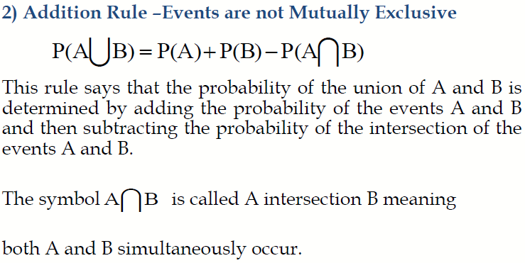
Rules for Computing Probability
A single 6-sided die is rolled. What is the probability of rolling a number greater than 3 or an even number?

Slide 13
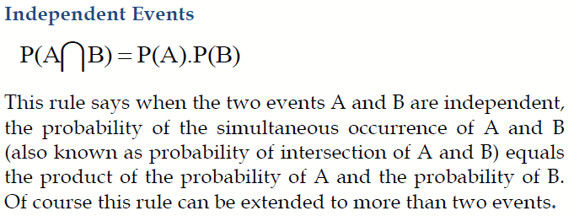
Multiplication Rule

Slide 14
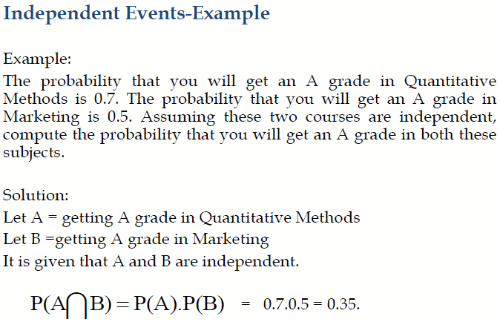
Multiplication Rule

Slide 15
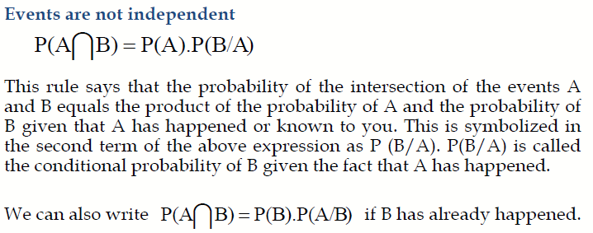
Multiplication Rule

Slide 16
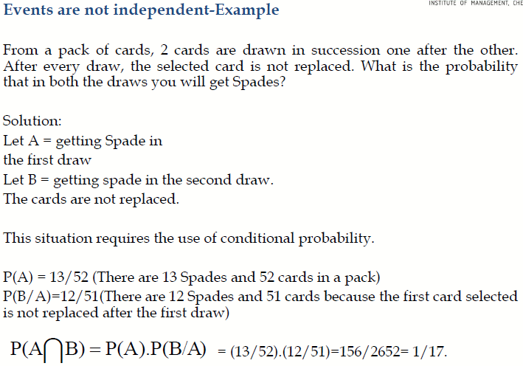
Multiplication Rule

Slide 17
Non independent example
Suppose you take out two cards from a standard pack of cards one after another, without replacing the first card. What is probability that the first card is the ace of spades, and the second card is a heart?
The two events are dependent events because the first card is not replaced.
There is only one ace of spades in a deck of 52 cards. So:
P(1st card is the ace of spades)=1/52
If the ace of spaces is drawn first, then there are 51 cards left in the deck, of which 13 are hearts:
P(2nd card is a heart | 1st card is the ace of spades)=13/51
So, by the multiplication rule of probability, we have: P(ace of spades, then a heart)=1/52*13/52

Slide 18
Marginal Probability
Contingency table consists of rows and columns of two attributes at different levels with frequencies or numbers in each of the cells. It is a matrix of frequencies assigned to rows and columns.
The term marginal is used to indicate that the probabilities are calculated using a contingency table (also called joint probability table).

Slide 19
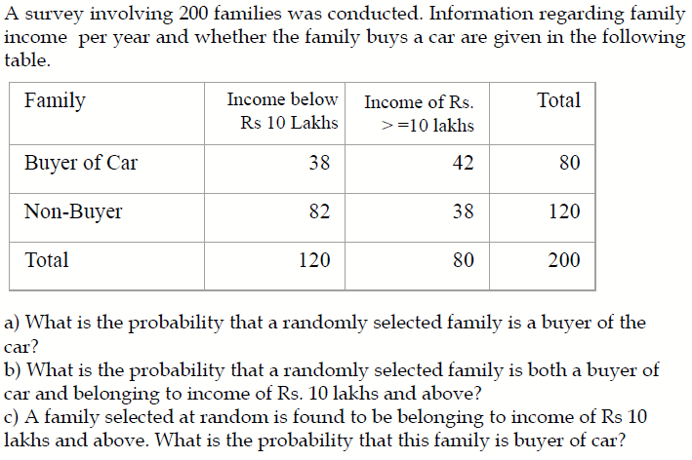
Marginal Probability - Example

Slide 20
Solution
a) What is the probability that a randomly selected family is a buyer of the Car?
80/200 =0.40.
b) What is the probability that a randomly selected family is both a buyer of car and belonging to income of Rs. 10 lakhs and above?
42/200 =0.21.
c) A family selected at random is found to be belonging to income of Rs 10 lakhs and above. What is the probability that this family is buyer of car?
42/80 =0.525. Note this is a case of conditional probability of buyer given income is Rs. 10 lakhs and above.

Slide 21
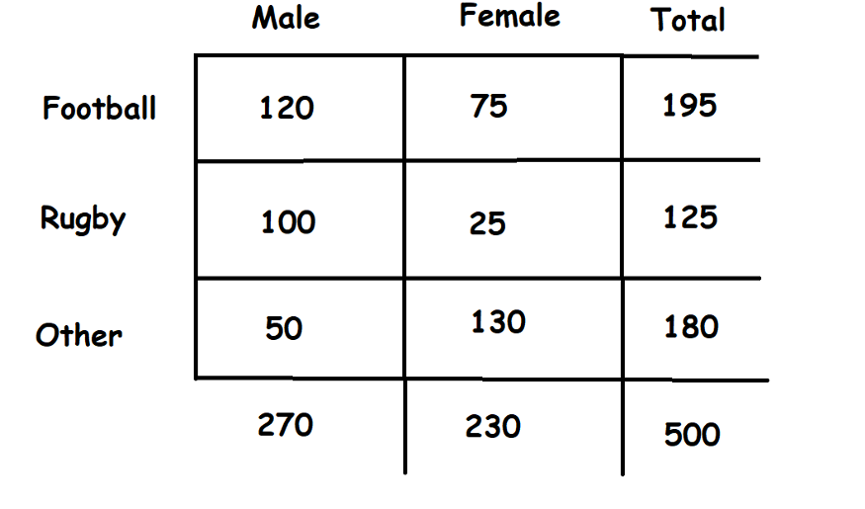
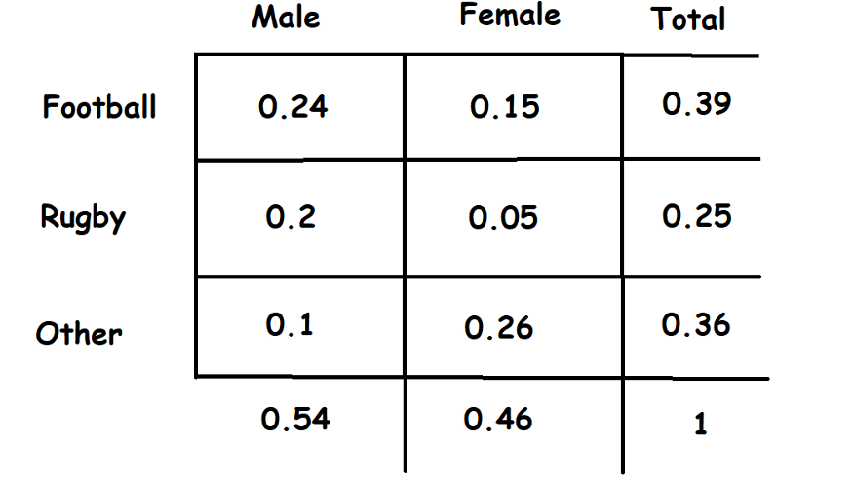
Joint and marginal
The Joint probability is a statistical measure that is used to calculate the probability of two events occurring together at the same time — P(A and B) or P(A,B)
Marginal probability: Marginal probabilities are at margins

Slide 22

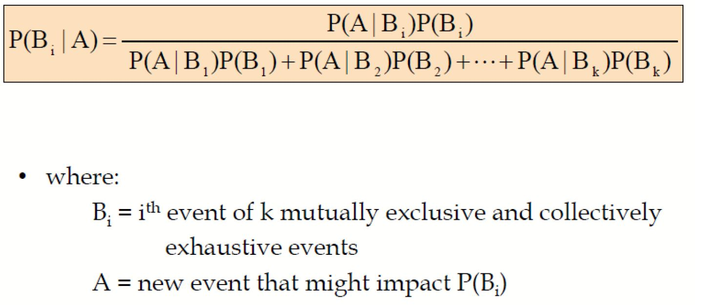
Bayes’ Theorem
Where:
P(A|B) – the probability of event A occurring, given event B has occurred
P(B|A) – the probability of event B occurring, given event A has occurred
P(A) – the probability of event A
P(B) – the probability of event B

Slide 23

Bayes theorem Problem
• A drilling company has estimated a 40% chance of striking oil for their new well.
• A detailed test has been scheduled for more information. Historically, 60% of successful wells have had detailed tests, and 20% of unsuccessful wells have had detailed tests.
•Given that this well has been scheduled for a detailed test, what is the probability that the well will be successful?
 | Success | UnSuccess
Detailed Test | 24 | 12 | 36
Non Detailed Test | 16 | 48 | 64
 | 40 | 60

Slide 24
Answer
 | Success | No Success
Detailed Test | 24 | 12 | 36
No detailed Test | 16 | 48 | 64
 | 40 | 60 | 100
P(S/DT)=24/36=0.67

Slide 25
Spam or ham
In my Gmail account 30% of the received e-mails are spam
80% of the spam messages contains the “offer”
10% of my ham e-mails contains “offer”
If I receive a new message which contains ‘offer’, what is the probability that it is spam?
 | Spam | No spam(ham)
Message contains offer | 24 | 7 | 31
Msg does not contain offer | 6 | 63 | 69
 | 30 | 70 | 100
P(spam/offer)=24/31 =77.4%
P(s/o)= P(s)*P(O/S)/P(o) =.3*24/30*.31== .3*0.8/0.31

Slide 26
What is a Probability Distribution
In precise terms, a probability distribution is a total listing of the various values the random variable can take along with the corresponding probability of each value. A real life example could be the pattern of distribution of the machine breakdowns in a manufacturing unit.
The random variable in this example would be the various values the machine breakdowns could assume.
The probability corresponding to each value of the breakdown is the relative frequency of occurrence of the breakdown.
Go to EXCel

Slide 27
Binomial Distribution
The Binomial Distribution is a widely used probability distribution of a discrete random variable.
It plays a major role in quality control and quality assurance function. Manufacturing units do use the binomial distribution for defective analysis.
Binomial distribution is also being used in service organizations like banks, and insurance corporations to get an idea of the proportion customers who are satisfied with the service quality.

Slide 28
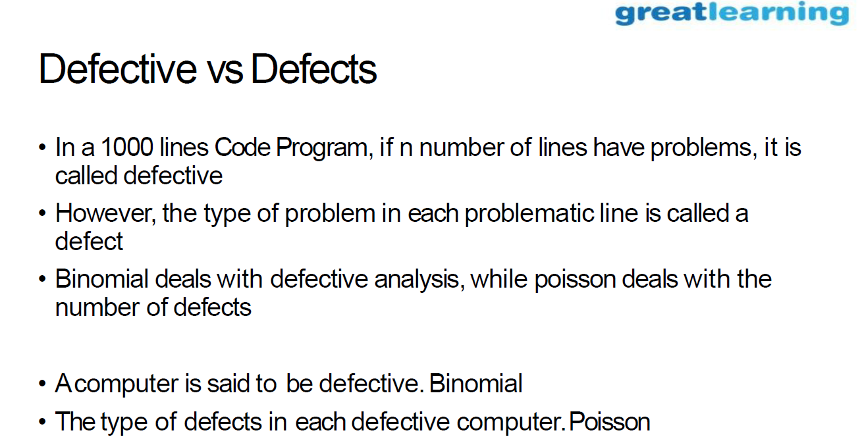

Slide 29
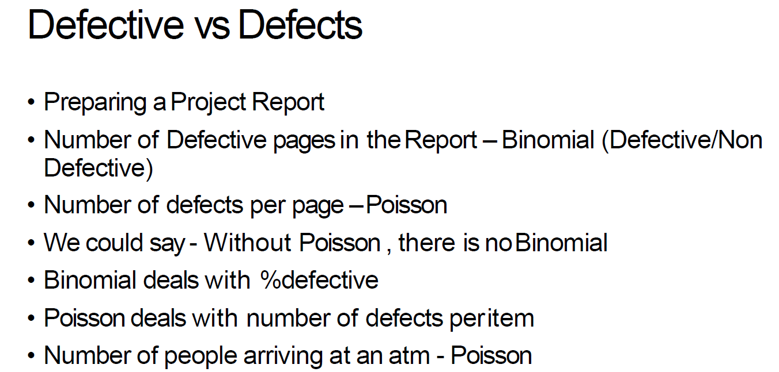

Slide 30
Defective Vs Defect
Ashok Leyland chooses Leather covers
Defective covers Binomial
Types of Defects in each cover black spots, thread cuts etc Poisson

Slide 31
Conditions for Applying Binomial Distribution (Bernoulli Process)
Trials are independent.
There are fixed number of trials (n trials).
There are only two outcomes of the trial designated as success or failure.
The probability of success is uniform through out the n trials

Slide 32
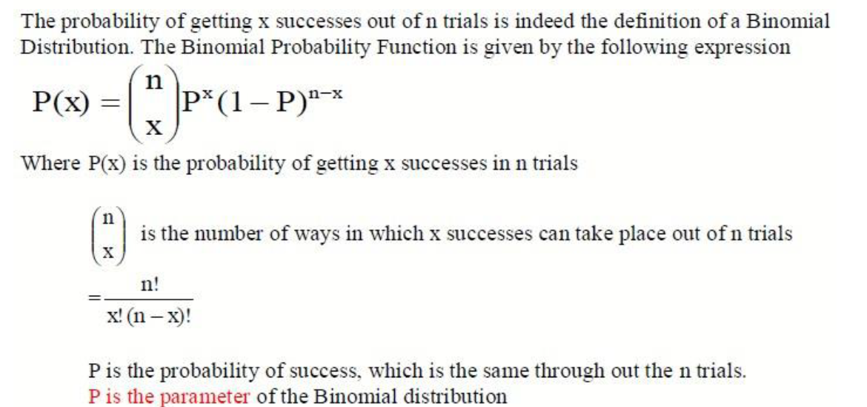
Binomial probability function

Slide 33
Example for Binomial Distribution
A bank issues credit cards to customers under the scheme of Master Card. Based on the past data, the bank has found out that 60% of all accounts pay on time following the bill. If a sample of 7 accounts is selected at random from the current database, construct the Binomial Probability Distribution of accounts paying on time.

Slide 34
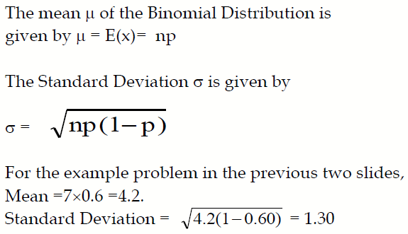
Mean and Standard Deviation of the Binomial Distribution

Slide 35
Poisson Distribution
Poisson Distribution is another discrete distribution which also plays a major role in quality control in the context of reducing the number of defects per standard unit.
Examples include number of defects per item, number of defects per transformer produced, number of defects per 100 m2 of cloth, etc.
Other examples would include 1) The number of cars arriving at a highway check post per hour; 2) The number of customers visiting a bank per hour during peak business period; 3) The number of pixels in the image that are corrupted.

Slide 36
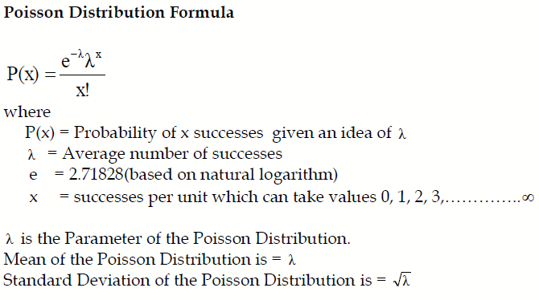
Poisson Probability Function

Slide 37
Example – Poisson Distribution
If on an average, 6 customers arrive every two minutes at a bank during the busy hours of working, a) what is the probability that exactly four customers arrive in a given minute? b) What is the probability that more than three customers will arrive in a given minute?

Slide 38
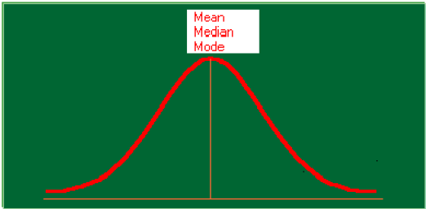
Normal Distribution

Slide 39
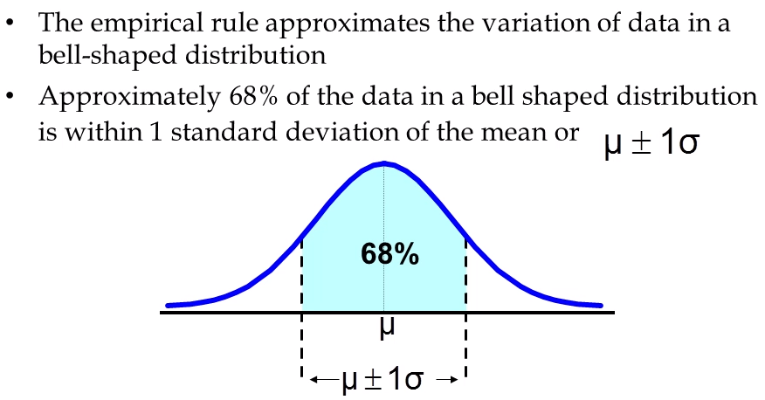
Normal Distribution

Slide 40
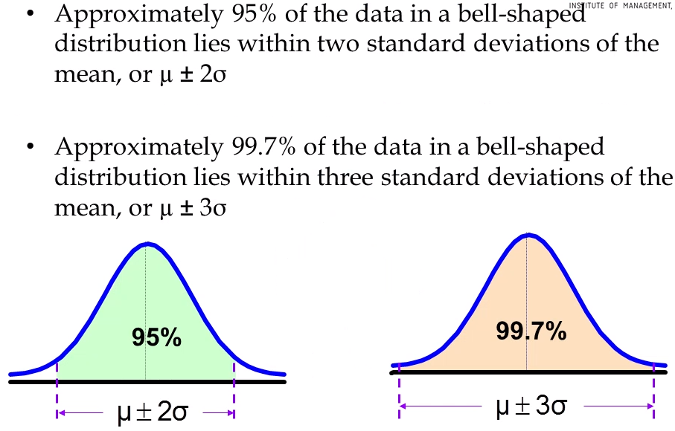
Normal Distribution

Slide 41
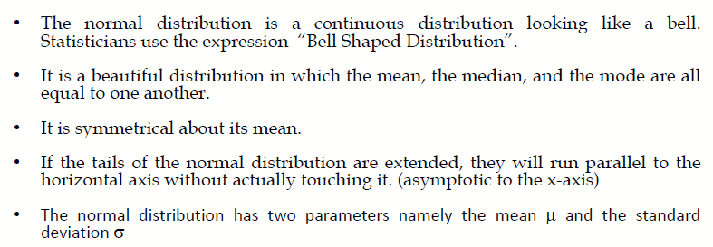
Properties of Normal Distribution

Slide 42
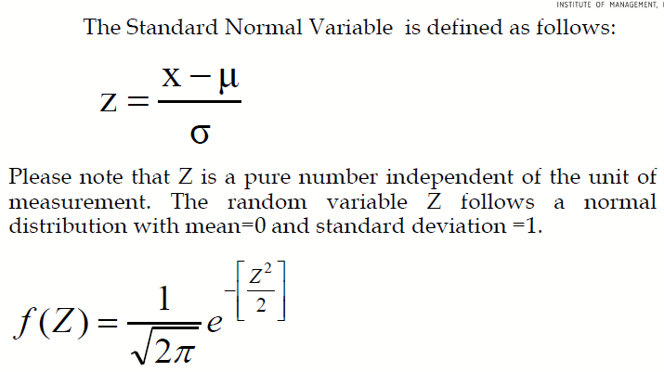
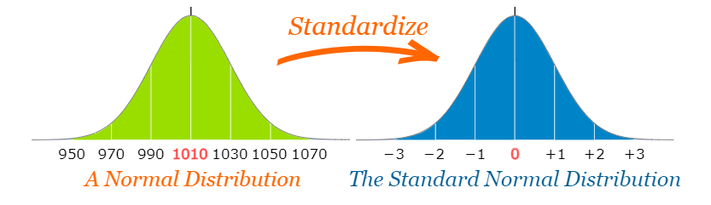
Standard Normal Distribution

Slide 43
Example Problem
The mean weight of a morning breakfast cereal pack is 0.295 kg with a standard deviation of 0.025 kg. The random variable weight of the pack follows a normal distribution.
a)What is the probability that the pack weighs less than 0.280 kg?
b)What is the probability that the pack weighs more than 0.350 kg?
c)What is the probability that the pack weighs between 0.260 kg to 0.340 kg?

Slide 44
Let’s summarize what we have learnt….

Slide 45
Case Study
Examples on Joint Probability and Conditional Probability
Binomial Distribution
Poisson Distribution
Computing Binomial probabilities for service at a Fast-Food Restaurant
Case study on Business Statistics Course based on Poisson and Normal Distribution

Slide 46


Questions?

